Slide 1
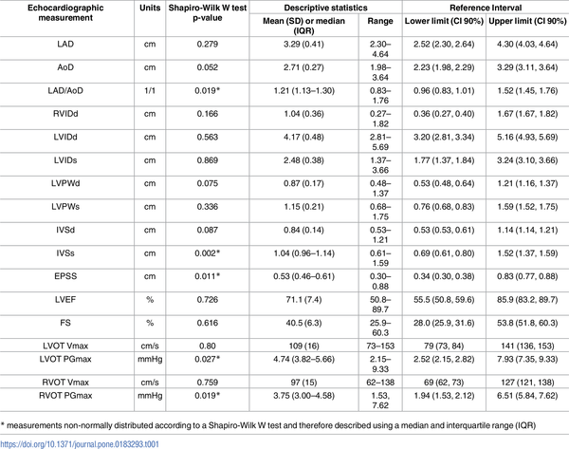

Table 1. Reference intervals of 17 2D, M-mode and pulsed wave Doppler echocardiographic measurements in 125 healthy adult dairy goats.
Szaluś-Jordanow O, Czopowicz M, Witkowski L, Mickiewicz M, Frymus T, et al. (2017) Reference intervals of echocardiographic measurements in healthy adult dairy goats. PLOS ONE 12(8): e0183293. https://doi.org/10.1371/journal.pone.0183293
https://journals.plos.org/plosone/article?id=10.1371/journal.pone.0183293

